Slide 1

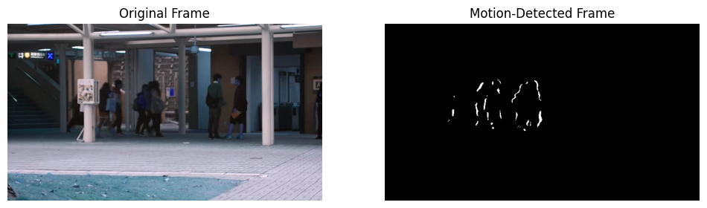





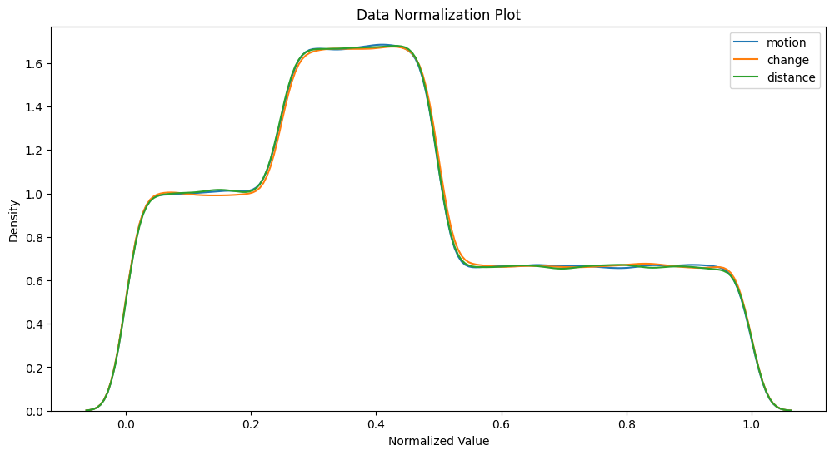
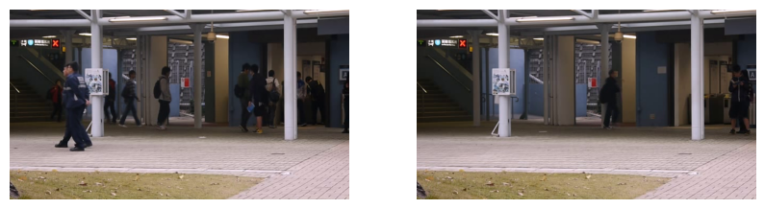
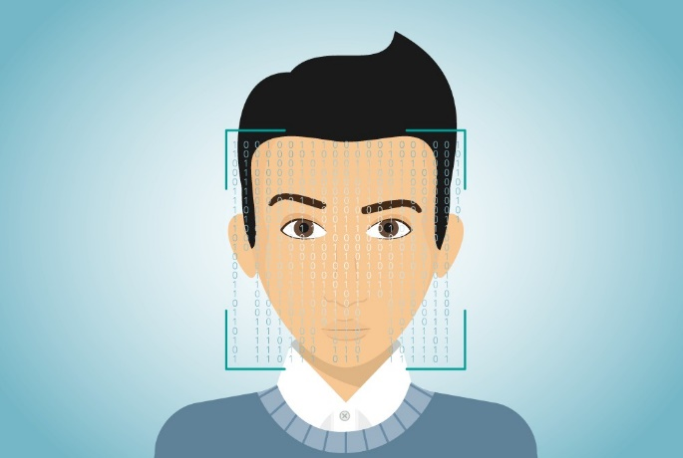
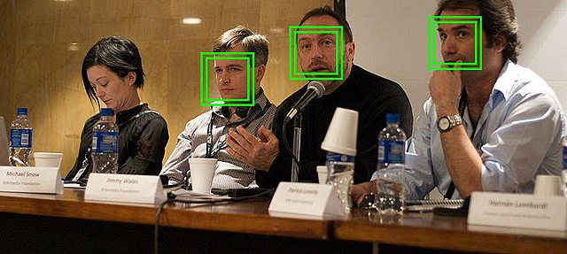
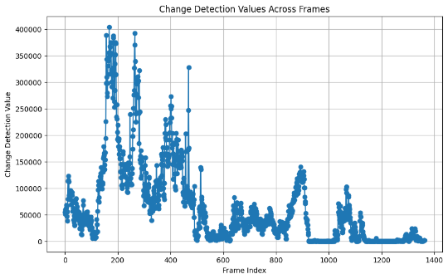
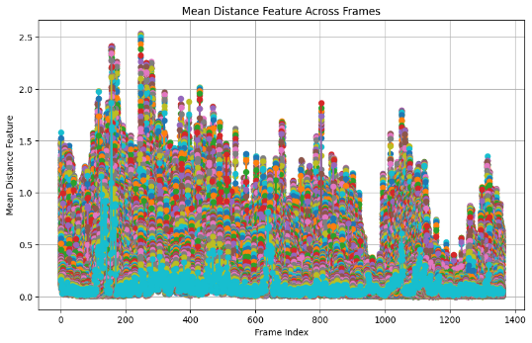
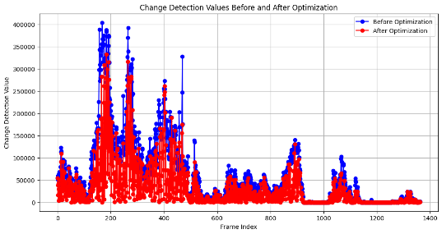
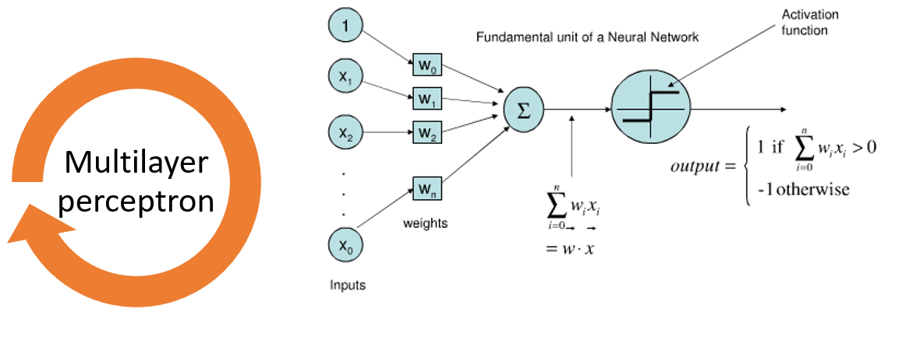




Advanced Face Detection Approach for Smart Surveillance Framework
Name: Muhammad Noman
MSc Data Science
Supervisor: Dr Muhammad Shan-A-Khuda
SCHOOL OF BUILT ENVIRONMENT, ENGINEERING AND COMPUTING
OVERVIEW
LITERATURE REVIEW
RESEARCH OUTCOME AND DISCUSSION
This project developed an advanced face detection system integrating data science practices with security and surveillance.
We optimised data for accurate feature extraction,
Utilized techniques such as ROI extraction,
Employed algorithms such as MLP and GWO for classification and optimisation
Overcoming challenges for real-world applications.
Ullah et al. (2022) highlighted the challenges faced by traditional face recognition methods in discerning objects accurately in complex video datasets.
Kumar et al. (2018) emphasized the importance of innovative methodologies for feature extraction and classification to improve the accuracy and efficiency of facial expression detection algorithms.
Dong et al. (2020) emphasized the significance of assessing the algorithm's applicability in real-world scenarios to ensure its effectiveness in dynamic video situations.
De-La-Torre et al. (2015) proposed an adaptive Multiple Classifier System (MCS) for video surveillance to enhance spatiotemporal recognition in video data.
Research Outcome: The project delivered a robust face detection method, integrating image processing, data science, and machine learning techniques. Its adaptable approach ensured applicability across various sectors, enhancing security measures, attendance tracking, and customer analytics.
Key Project Steps: The discussion highlighted essential project steps, including data pre-processing, ROI extraction, feature extraction, data optimisation, and classification, emphasizing their contributions to system effectiveness.
Evaluation of Machine Learning Models: MLP and random forest, identified strengths, weaknesses, and areas for improvement, informing future enhancements.
Limitations and Challenges: Environmental variations, computational constraints.
ETHICAL CONSIDERATIONS
AIM AND OBJECTIVES
The research aims to enhance face detection in surveillance systems while adhering to ethical principles, prioritizing privacy and responsible technology use.
Methodologies integrate ethical considerations into data processing, ensuring privacy during feature extraction and algorithm application.
Feature extraction techniques, including distance and motion detection, balance data utility with privacy preservation.
Integration of Grey Wolf Optimization and Multilayer Perceptron algorithms improves system performance.
The proposed solution aims to achieve a robust and effective method to detect faces and objects,
Extract the hand-crafting features,
Reduce the dimension with optimisation and classify the data.
This system can be applied to various domains, such as surveillance, sports, and other intelligent systems.
METHODOLOGY
The proposed method initiates by converting video data into frame sequences, followed by a preprocessing stage involving image resizing and noise reduction using a median filter.
Next step is extracting the region of interest (ROI), using techniques such as skin tone detection, edge detection, and motion detection. These methods aim to identify and extract relevant information.
Next steps involve feature extraction, including change detection, motion direction flow, and distance cosine features, to uncover hidden patterns within the data. Grey Wolf Optimisation (GWO) is applied to optimise the extracted features.
Multilayer Perceptron (MLP) algorithm is employed for decision-making, over the optimised feature set to train and generate predictions.
CONCLUSION
Our project focused on developing a face detection system in advanced data science principles. We initiated by collecting video-based datasets and preprocessing the data to ensure uniformity and minimize noise for subsequent analysis.
Extraction of facial features through advanced techniques such as motion, change, and distance enabled the utilization of characteristic features for classification.
Implementation involved organizing facial outlines using the Multilayer Perceptron (MLP) algorithm.
Grey Wolf Optimisation (GWO) used for data optimisation.
Limitations: Environmental conditions, computational resource constraints, and ethical considerations. Addressing these challenges ensured the system's effectiveness and ethical deployment, paving the way for future advancements in this field.
RATIONALE
ACKNOWLEDGEMENTS
Enhancing face recognition in surveillance is crucial for security.
Existing methods face challenges such as lighting and motion variations, reducing accuracy.
Modern face recognition techniques, especially those using machine learning, aim to overcome these limitations.
This research seeks to improve surveillance systems' reliability, accuracy, and efficiency through innovative methodologies, contributing to enhanced security measures.
I extend my heartfelt gratitude to my thesis supervisor, Dr Mohammad Shan-A-Khuda, for his guidance, support, and mentorship throughout the research journey.
I express my gratitude to my family, and friends, for their encouragement, understanding, and cooperation.
REFERENCES

Slide 2
Here the link to get the recorded presentation of Poster:
https://youtu.be/jslkB8bTgtw
2. Google Drive link to get the related file to my Project:
https://drive.google.com/drive/folders/1Klw1WsuUMlIKAEKQ4wE03zuU1m4_sHiC?usp=sharing

